Slide 1
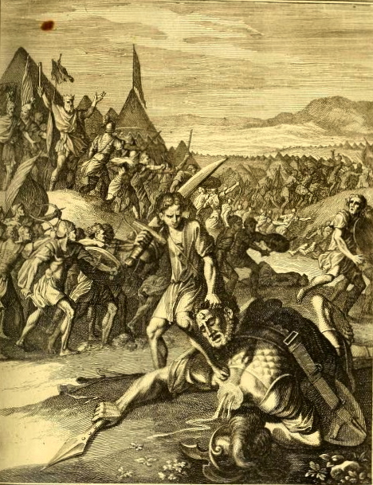
David and Goliaths:
Wartime Sermons in Orthodox Russia, 1700-1815
Andrey V. Ivanov
University of Wisconsin at Platteville
July 9, 2020

Slide 2
SERMONS AS PROPAGANDA

Slide 3
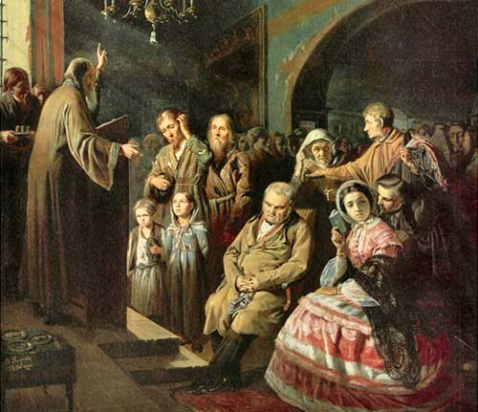
V. G. Perov, A Village Sermon (1861)

Slide 4
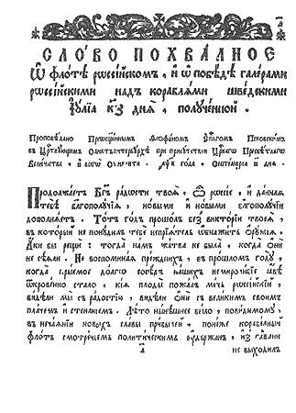
First page from Feofan Prokopovich’s military sermon delivered in St. Petersburg on 8 September 1720 on the occasion of the celebration of the victorious battle of Ledsund (Granhamn) and printed that year by Peter’s decree in the printing press of the Alexander Nevsky Monastery.
Typical printing run for a sermon was 600 (poluzavod) to 1200 (zavod) copies.

Slide 5
Like in Western Europe Russia’s military sermons did not only seek to incite the Russian
troops and officer corps with a patriotic telos, but also communicated the aims and
the experiences of war to the home front - the lay audiences of Russia’s Orthodox
devotees who supported the empire’s military through taxes, conscripts and prayers.

Slide 6
Like in Western Europe Russia’s military sermons did not only seek to incite the Russian
troops and officer corps with a patriotic telos, but also communicated the aims and
the experiences of war to the home front - the lay audiences of Russia’s Orthodox
devotees who supported the empire’s military through taxes, conscripts and prayers.
Like in many cases in Western Europe (especially in France), the preachers’ knowledge of
the military campaigns, strategies, plots and events was rather extensive and was the result
of their close relationships with the court.

Slide 7
Like in Western Europe Russia’s military sermons did not only seek to incite the Russian
troops and officer corps with a patriotic telos, but also communicated the aims and
the experiences of war to the home front - the lay audiences of Russia’s Orthodox
devotees who supported the empire’s military through taxes, conscripts and prayers.
Like in many cases in Western Europe (especially in France), the preachers’ knowledge of
the military campaigns, strategies, plots and events was rather extensive and was the result
of their close relationships with the court.
Unlike in Western Europe in the eighteenth century, the preachers did not employ sectarian
rhetoric to depict the image of the enemy. They preferred to describe the wars as defensive,
with weak Russia facing a strong, gargantuan aggressor at impossible odds.
The metaphor of David facing Goliath was by far the most favorite image used.

Slide 8
Like in Western Europe Russia’s military sermons did not only seek to incite the Russian
troops and officer corps with a patriotic telos, but also communicated the aims and
the experiences of war to the home front - the lay audiences of Russia’s Orthodox
devotees who supported the empire’s military through taxes, conscripts and prayers.
Like in many cases in Western Europe (especially in France), the preachers’ knowledge of
the military campaigns, strategies, plots and events was rather extensive and was the result
of their close relationships with the court.
Unlike in Western Europe in the eighteenth century, the preachers did not employ sectarian
rhetoric to depict the image of the enemy. They preferred to describe the wars as defensive,
with weak Russia facing a strong, gargantuan aggressor at impossible odds.
The metaphor of David facing Goliath was by far the most favorite image used.
Russia’s bishops did not view Russia as a bastion of Orthodoxy juxtaposed against
its heretical neighbors, but rather as an ecumenical Christian power, as a part of
European Christendom, a participant in its system of alliances and even a defender of
its interests. NB: This ecumenical toleration, however, did not extend to Islam.

Slide 9
The image of the enemy – in Russia and the West?

Slide 10
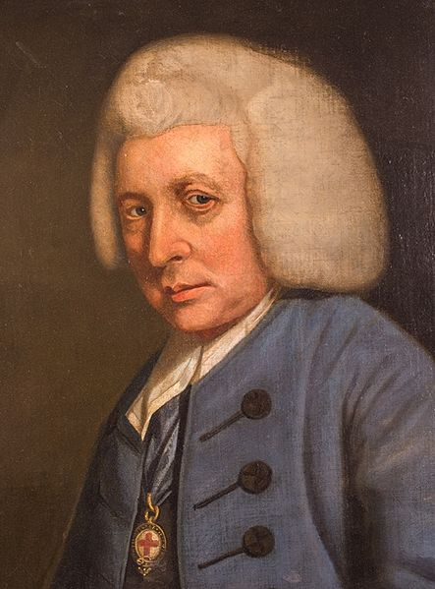
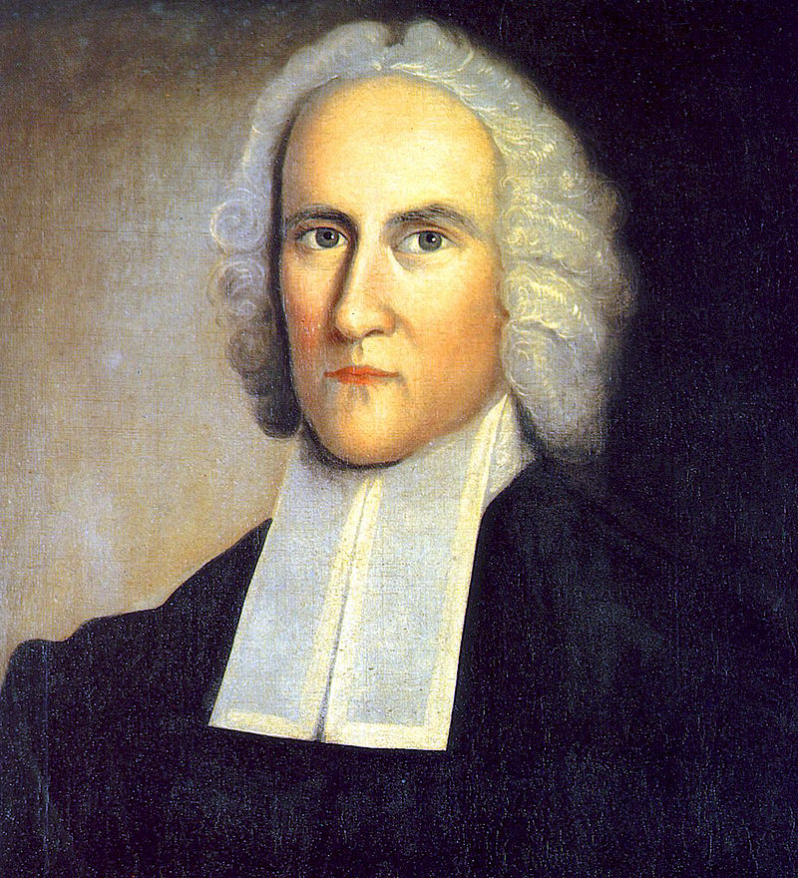
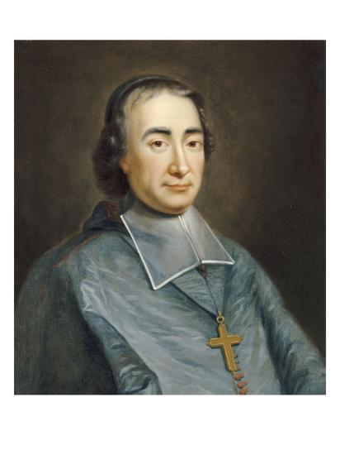
British, North American and French Catholic preachers often viewed the wars as religious
conflicts, fought to vanquish “heretics” and heterodox. John Hume (1706-1782), Jonathan
Edwards (1703-1758), and Jean-Baptiste Massillon (1663-1742).

Slide 11
David vanquishes Goliath –
an illustration from the Russian Slavonic
Bible of 1751.
Biblia, siriech knigi sviashchennago pisaniia vetkhago i novago zavieta
(St. Petersburg, 1751)

Slide 12
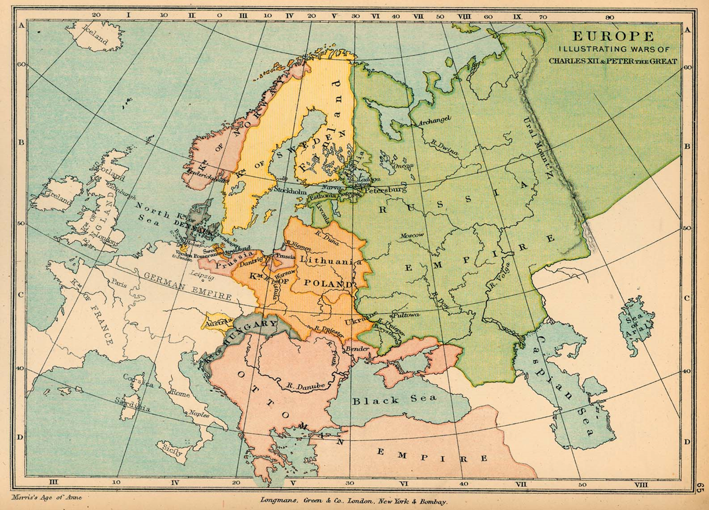
THE GREAT NORTHERN WAR, 1700-1721

Slide 13
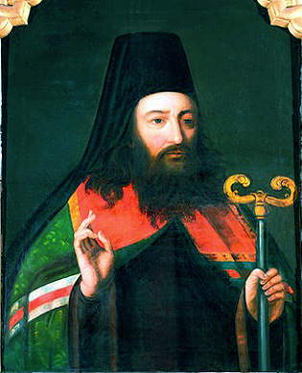
Gavriil [Buzhinskii] (d. 1731), Over-Hieromonk [ober-ieromonakh]
of the Russian Navy and the bishop of Riazan’.

Slide 14
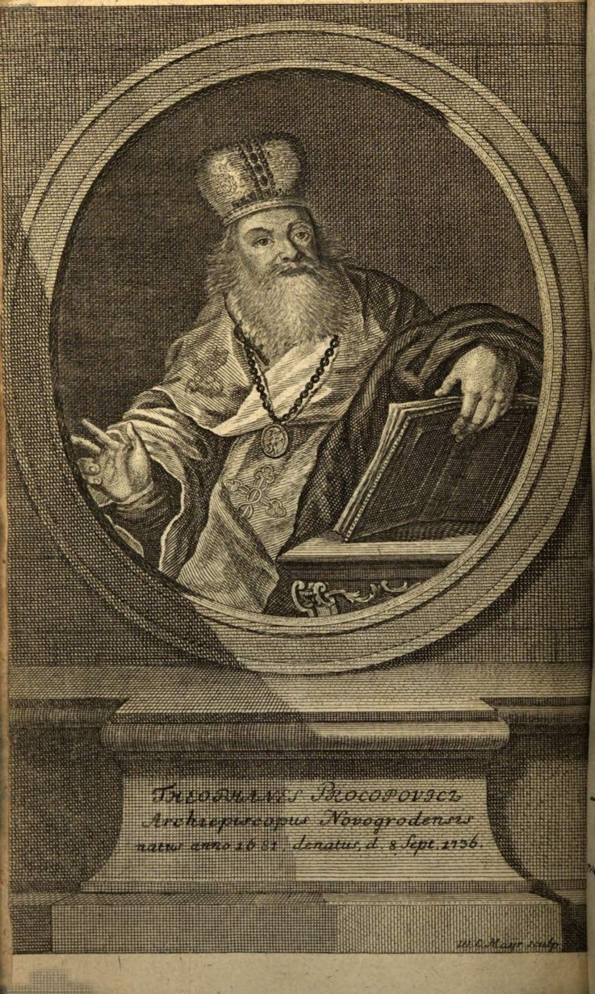
Archbishop Feofan Prokopovich
[secular name, в миру,
Elisei Tsereiskii] (1681-1736)
Scan a courtesy of the Bavarian Library
(Bayerische Staatsbibliothek), Munich.

Slide 15
1717-1718 Church Year Sermons Cycle: Buzhinskii and Prokopovich
“Proud jealousy and jealous pride”
Saving Russia’s “brotherly nations”
“Cruel Goths” attacking Lutheran “holy churches”
Swedish people “tough like iron, like the glorious Swedish iron”

Slide 16
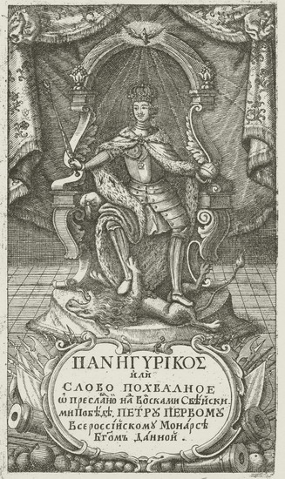
The Battle at Poltava:
“The mother of all battles.”
“David’s victory over the proud Philistine.”
Tsar Peter triumphant over Swedish lion. Front illustrtation of Feofan Prokopovich’s Homily on the Victory at Poltava of 1709, Slovo pokhval’noe o batalii poltavskoi (St. Petersburg, 1717).
Scan a courtesy of the Library of Congress collections.

Slide 17
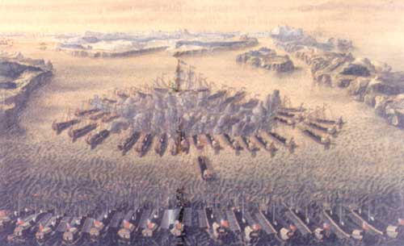
The battle at Hangö udd. Etching by Maurice Baquoi, 1724—1727

Slide 18
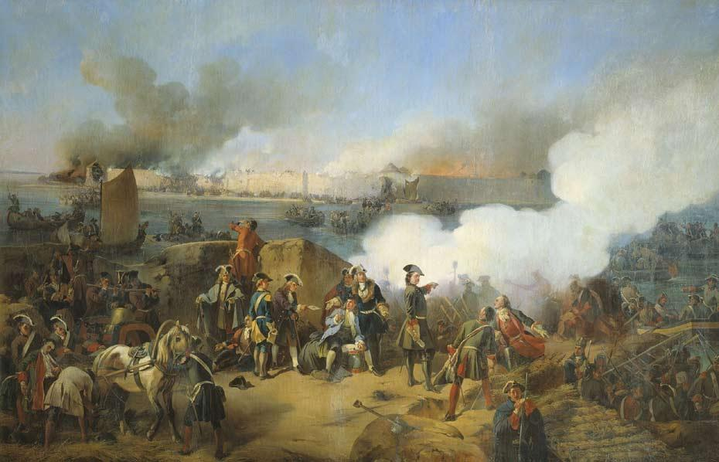
The siege of Nöteborg . Painting by Alexander von Kotzebue.

Slide 19
1721 Peace of Nystadt Homily
Jealousy = fraternal
“Valliant Swedes [khrabrye svei]”

Slide 20
The War for Polish Succession

Slide 21
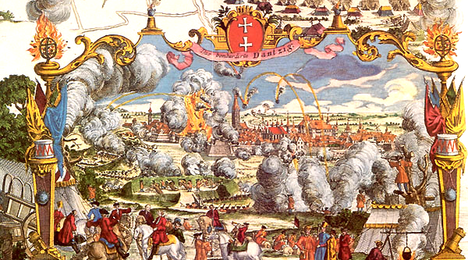
The Siege of Danzig (1734)

Slide 22
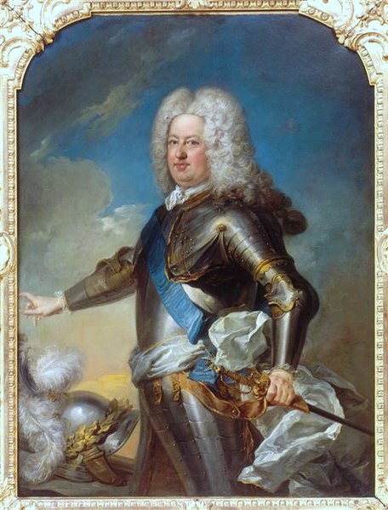
Stanisław Leszczyński (1677-1766),
King of Poland 1733-1736.
Painting by Jean-Baptiste van Loo

Slide 23
THE SEVEN YEARS WAR 1756-1763

Slide 24
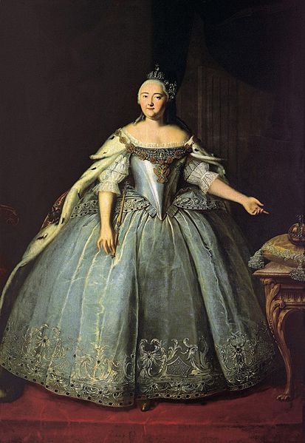
Empress Elizabeth (painting by Ivan Vishniakov, 1743)
*Patronized preachers and preaching at the court and in
Russia.

Slide 25
Empress Elizabeth (painting by Ivan Vishniakov, 1743)
*Patronized preachers and preaching at the court and in
Russia.
*In 1742, for example, she has attended some 51 sermons.

Slide 26
Empress Elizabeth (painting by Ivan Vishniakov, 1743)
*Patronized preachers and preaching at the court and in
Russia.
*In 1742, for example, she has attended some 51 sermons.
*Synodal Printing Press published 24,000 copies of various
sermons preached that year.

Slide 27
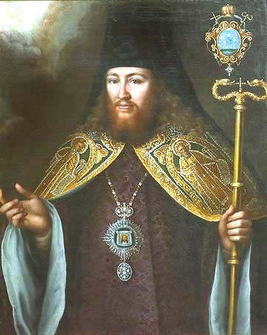
Gedeon Krinovskii, Archbishop of Pskov and the most popular preacher during the Seven Years War. This the “lively, emancipated monk” (in the words of P. V. Znamenskii) wore face powder and wigs, braided his beard, put on the stockings and diamond-decorated shoes of the latest European fashion and had a walk-in closet of silk cassocks.

Slide 28
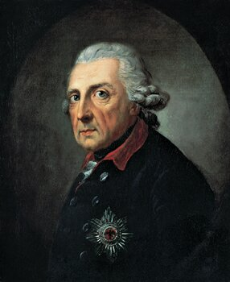
Frederick the Great of Prussia (aged 66 here in the painting by A. Graff) was the object of Gedeon’s homiletic interpretation of the Seven Years’ War.
Preaching to the courtiers and the General Staff, Krinovskii condemned Frederick as “disruptor of common peace,” his “lust for power” and contrasted him against Empress Elizabeth, the “new David, who lusted for no power, turning her thoughts only towards maintaining peace in her own country…as well as in other countries, if possible.”

Slide 29
THE NAPOLEONIC ARMAGGEDDON

Slide 30
December 1806 Manifesto (Ob’iavlenie) of the Holy Synod:
Peasants and lower classes must join the militia to confront Napoleon.
Napoleon –
Atheist

Slide 31
December 1806 Manifesto (Ob’iavlenie) of the Holy Synod:
Peasants and lower classes must join the militia to confront Napoleon.
Napoleon –
Atheist
Muslim

Slide 32
December 1806 Manifesto (Ob’iavlenie) of the Holy Synod:
Peasants and lower classes must join the militia to confront Napoleon.
Napoleon –
Atheist
Muslim
Jew

Slide 33
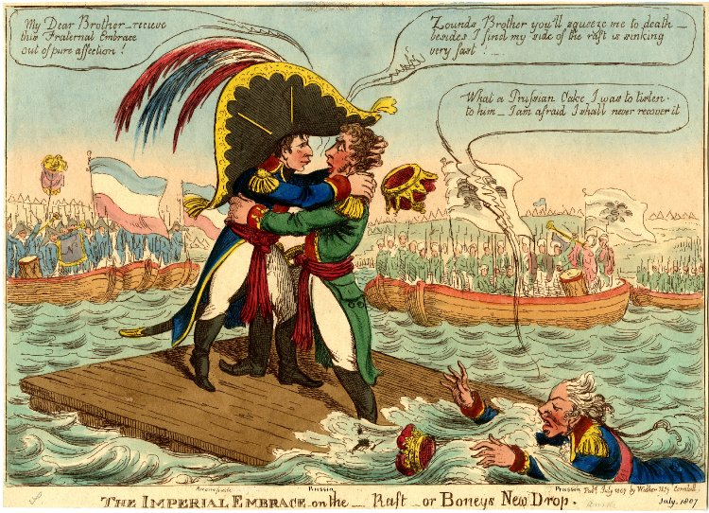
Meeting of Alexander I and Napoleon at Neman river, near Tilsit, in July of 1807, less than a
year after the tsar strong-armed the Synod into labeling Napoleon a Jewish Atheist Muslim.
Illustration: The Imperial Embrace, 1807. The British Museum.

Slide 34
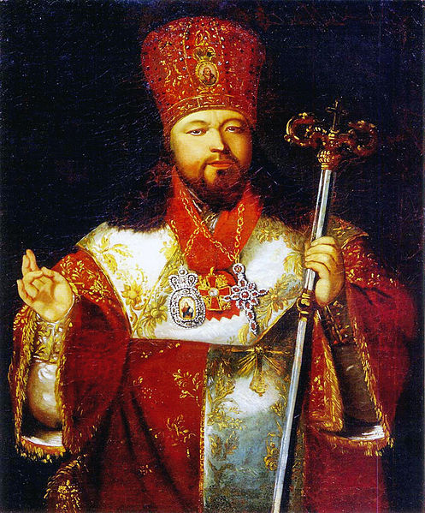
Archbishop Avgustin Vinogradskii (1766-1818) creatively extolled the virtues of the “Savior of Europe” (tsar Alexander) in his sermons devoted to the 1807 peace with Napoleon and then, the 1812-1815 war against the “proud Goliath.”

Slide 35
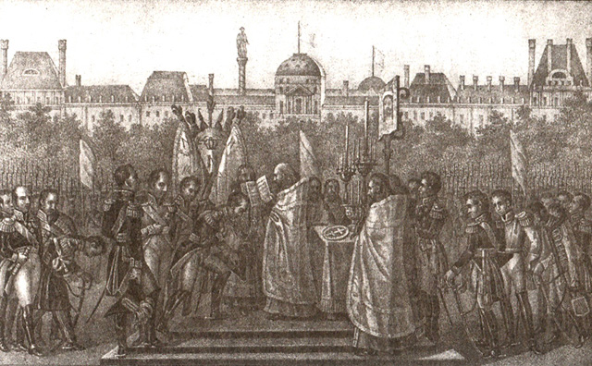
Boris Chorikov, “Thanksgiving Service upon Russians’ entry into Paris,” engraving from
the first half of 19th c.

Slide 36
“FOR FAITH AND THE FAITHFUL” – THE RUSSO-OTTOMAN WARS

Slide 37
Gavriil Buzhinskii (1680-1731)

Slide 38
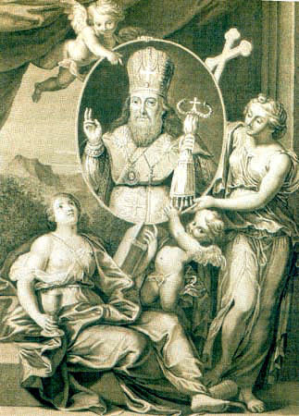
Platon Levshin (1737-1812), the “enlightened prelate” and Metropolitan of Moscow. “Father
Platon does to us whatever he wishes us to be,” said Catherine the Great, “If he wants us to
cry – we cry, if he wants us to rejoice – we rejoice!”

Slide 39
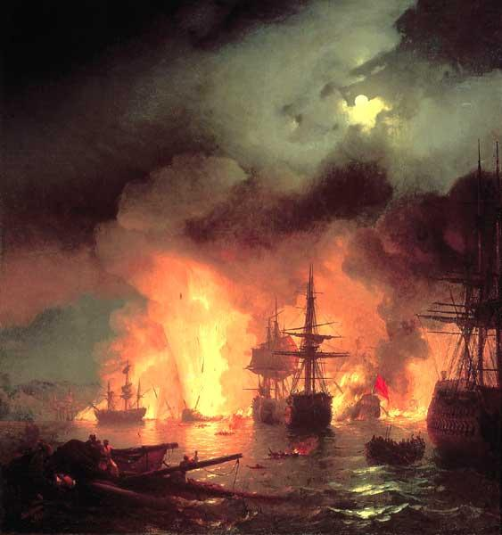
Battle of Chesme, July 1770. I. Aivazovskii

Slide 40
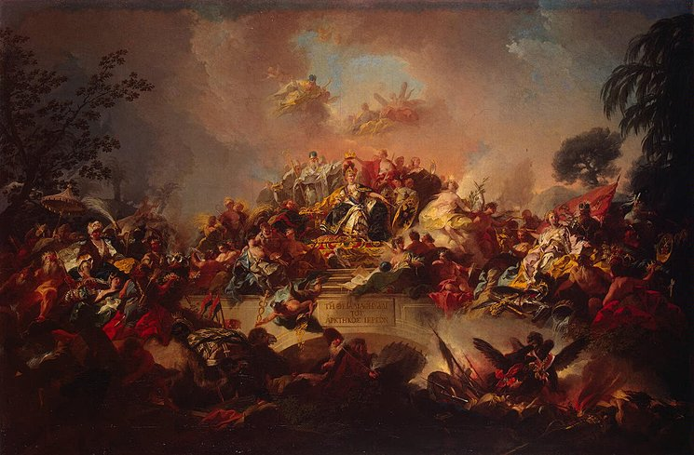
Apotheosis of Catherine the Great, the New Roman Empress, 1767, by Gregorio Gugliemi

Slide 41
CONCLUSION:
Military sermons sought to present Russia as an ecumenical defender of Christian Europe,
not an isolated island of orthodoxy surrounded by heretics.
Military sermons demonstrate bishops’ high level of knowledge of current events,
foreign policy, and diplomatic strategy. Since the bishops lived in two worlds – as occasional
preachers in the imperial capital and as administrators of their rural dioceses – they were
uniquely qualified to carry the message to the largely illiterate masses of Orthodox Russia.
-- Thirdly – the example of Ottoman wars show how the well-established patterns of Russian
foreign policy and diplomatic strategy actually find their origins in the 18th century.
For example, Polish policy. Or, Constantinople 1914. Russia’s question of the straights
was not a part of the Greek Q or Greek national issue.
The study of ecclesiastical military propaganda in the early imperial period sets the
agenda for the study of Orthodox sermons during the Crimean War, the First World War and
especially, World War II.

Slide 42
EPILOGUE: WARTIME SERMONS BEYOND 1815

